Slide 1
Dudley & Netherton PCN
Patient Participation Group

Slide 2
Welcome
Welcome & Introductions – Samson Arishe
Housekeeping
Plan for session:
Actions from last meeting
Your Health Dudley – Maria Doria
PPG Education Session (High blood Pressure/ Hypertension Management) – Sabah Khan and Gurvinder Najran
Table Discussions
Next PPG Meeting

Slide 3
Ground Rules
• All views are valid and will be listened to
• Respect each person’s opinion
• Allow people to speak out if there is something they don’t understand
• Individual complaints/issues will not be discussed at this forum.
• All information discussed by PPG members will remain confidential
• Members will demonstrate a commitment to delivering results as a group
• Being a member of the PPG does not entitle that individual to preferential treatment above other patients

Slide 4
Since Our Last PPG
Last PPG was focused on Digital Inclusion and barriers to this
Care Navigation training for our Reception Team
Enables the team to direct patients to the right service for them including digital services where appropriate
PCN Directory of Service (DOS) was created to ensure all PCN patients get the same service offer regardless of which GP surgery they are registered with

Slide 5
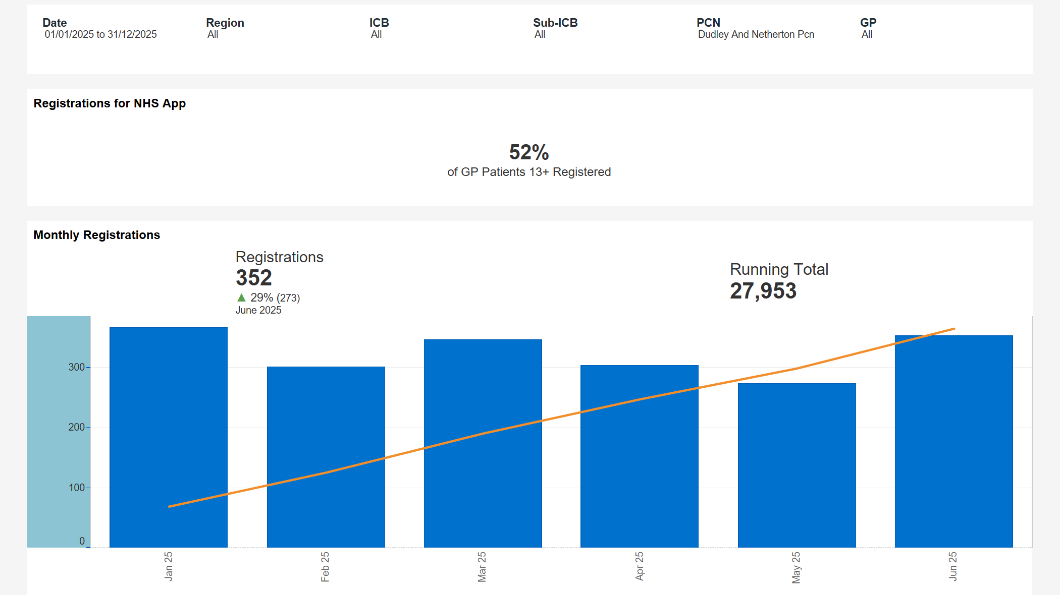

Slide 6
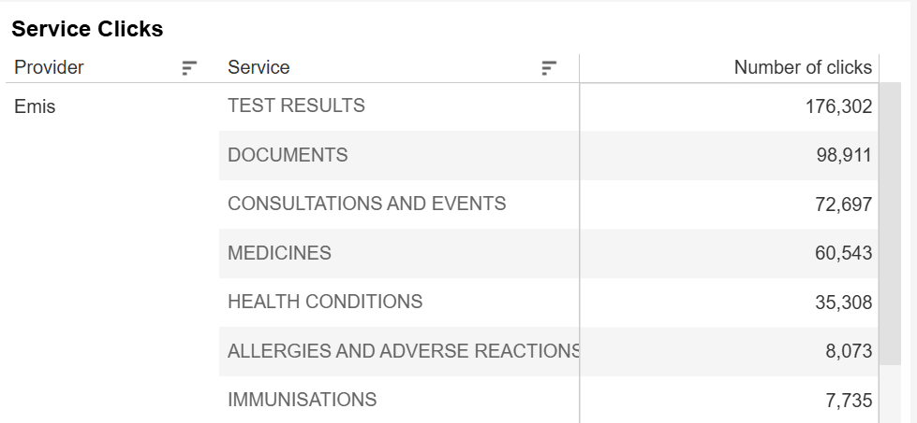

Slide 7


Healthier, Happier for Longer

Slide 8
Our Services
Stop Smoking Support
Weight Management Support
Family Healthy Lifestyles
NHS Health Checks
Steps to Health

Slide 9

Stop Smoking Support
12 weeks behavioural support
Support both smoking and vaping cessation
FREE Nicotine Replacement Therapy
Swap-to-stop Nicotine Vape Scheme
Carbon Monoxide readings
Face to Face Appointments with Telephone Support if required
NEW App to be used alongside course from December 2025.
Eligibility:
Over 18
Live, work or registered with a Dudley GP

Slide 10

Weekly topics include –
Portion Sizes
Food Labels
Moving More
Snacking
Food & Mood
Stress Management
Social Eating
Alcohol
Back To Basics (Home cooking)
Food Groups
Intuitive Eating
Self Monitoring
Energy Balance
Weight Gain Factors
Weight Management
Eligibility
For people wanting to lose weight and keep it off long-term, our face-to-face weekly classes will help you manage your weight through balanced nutrition and simple exercise
Live, work OR registered with a GP in the Dudley Borough
BMI Over 25 (or over 23 - Asian ethnicity or any other BAME group)
Physical Activity Readiness Questionnaire required
Participants will receive advice and encouragement to make healthier lifestyle choices, together with light physical activity with a qualified instructor in a group setting.
Now also offering online courses via Microsoft Teams.
Female only group nutritional/exercise courses

Slide 11
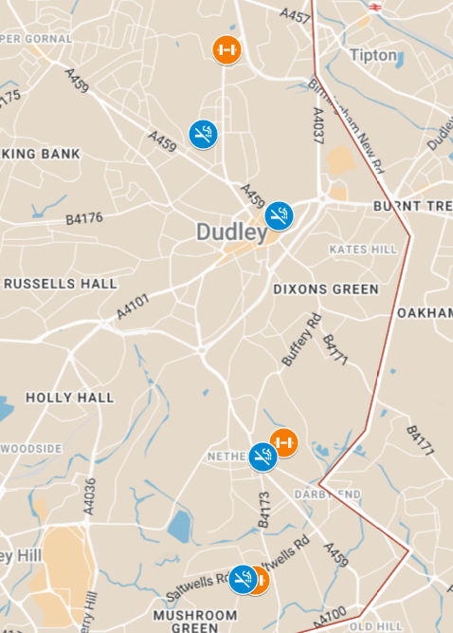

Dudley/Netherton Courses
Smoking Cessation
Castle & Priory Neighbourhood Learning Centre
King Charles House (Main Office, Dudley)
The Savoy Centre, Netherton
Dudley Wood Neighbourhood Learning Centre
Weight-Management
Priory Hub, Dudley
Netherton Park Hub
Dudley Wood Learning Centre
Other Course Locations:
Brierley Hill
Pensnett
Coseley
Sedgley
Halesowen
Stourbridge
Lye
ONLINE WM COURSES

Slide 12
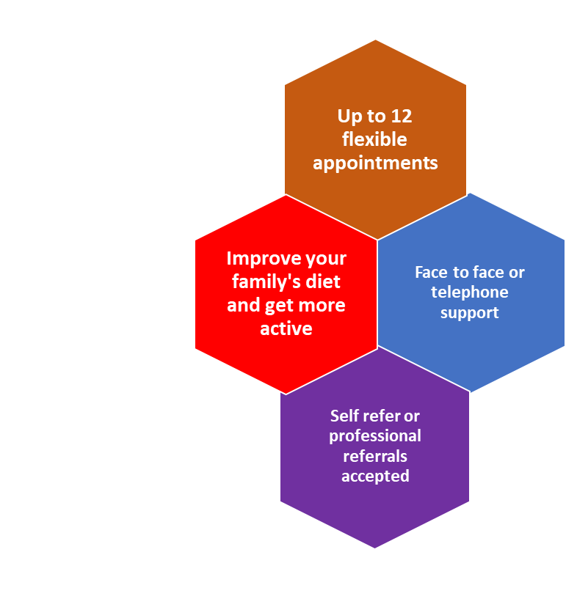
Family Healthy Lifestyles
Eligibility Criteria
Children aged between 4-18
and meets one of the following:
  Live in Dudley Borough
  Registered with a Dudley GP
  Child attends a Dudley Borough education setting.
“He’s got so much more energy and confidence now, he’s started playing football at school which he never would have done before”- Dudley Family
After making small changes with the family service

Slide 13
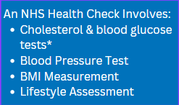



NHS Health Checks
Everyone is at risk of developing heart disease, stroke, diabetes, kidney disease and some forms of dementia. The good news is that these conditions can often be prevented.
If you are aged between 40-74, not
previously diagnosed with any of the following, then you may be eligible
for a free Health Check.
Coronary heart disease
Chronic kidney disease (CKD stages 3-5)
Diabetes
Heart Failure
Previous stroke
Peripheral Arterial Disease
Hypertension
Familial Hypercholesterolaemia
Atrial Fibrillation
Transient Ischaemic Attack (TIA)
Prescribed statins or hypertensives
If you do have any of the above or are below the age of 40, we also offer Mini Health checks, which involves a lifestyle assessment, BMI measurement and blood pressure checks
Workplace Health Check
days also available

Slide 14

Steps-to-Health
We work in partnership with Dudley Leisure Centres to provide forms for discounted membership
Duncan Edwards Leisure Centre
Halesowen Leisure Centre
Crystal Leisure Centre
£23 per month direct debit
50% off ‘pay and play’
Eligibility:
Clients must live, work or be registered at a Dudley GP
Cannot already hold a membership (or within last 6months)
Can only use the form once

Slide 15
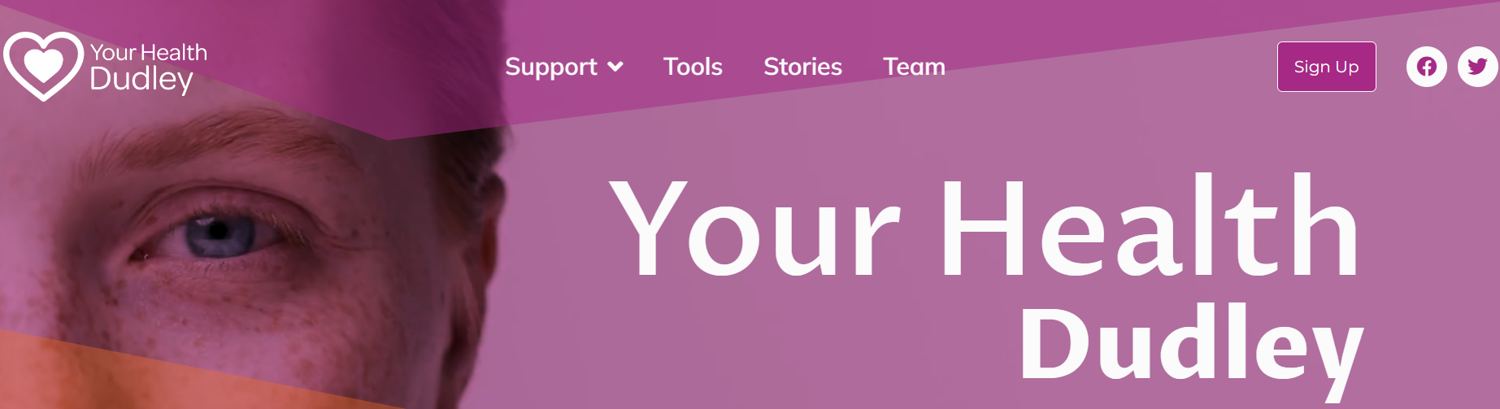
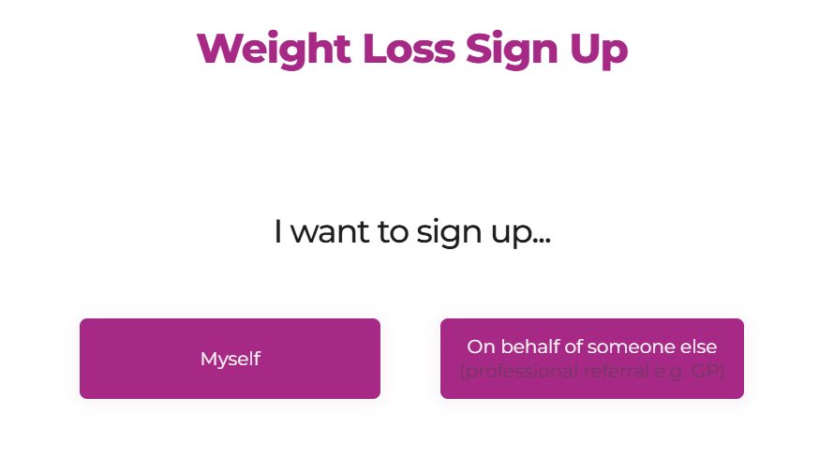
How to Refer to Our Services:
Via our website: https://yourhealthdudley.co.uk/
Calling 01384 732 402
Emailing us via yourhealth.dudley@nhs.net
We accept both self and professional referrals

Slide 16

Thank You For Listening!
Any
Questions?
Head of Service: Sarah Fisher – sfisher@ablhealth.co.uk
Smoking Cessation Lead: Steven Albutt- salbutt@ablhealth.co.uk

Slide 17


Hypertension Management
Sabah Khan- MRPharmS, PGClinDip, I.presc PGCert MH Ther.
Dudley and Netherton PCN Lead Pharmacist
Gurvinder Najran - MRPharmS, Dip, I.presc, PG Cert
Sedgley Coseley and Gornal (Dudley) Primary Care Pharmacist
Black Country Integrated Care Board

Slide 18
Introductions and Agenda:
What is Hypertension ?
Community Pharmacy and Blood Pressure Services
What is Ambulatory Blood Pressure Monitoring (ABPM)
Home Blood Pressure Monitoring (HBPM)
Helping YOU to Complete Home Blood Pressure Readings
Questions and Discussion
Black Country Integrated Care Board

Slide 19
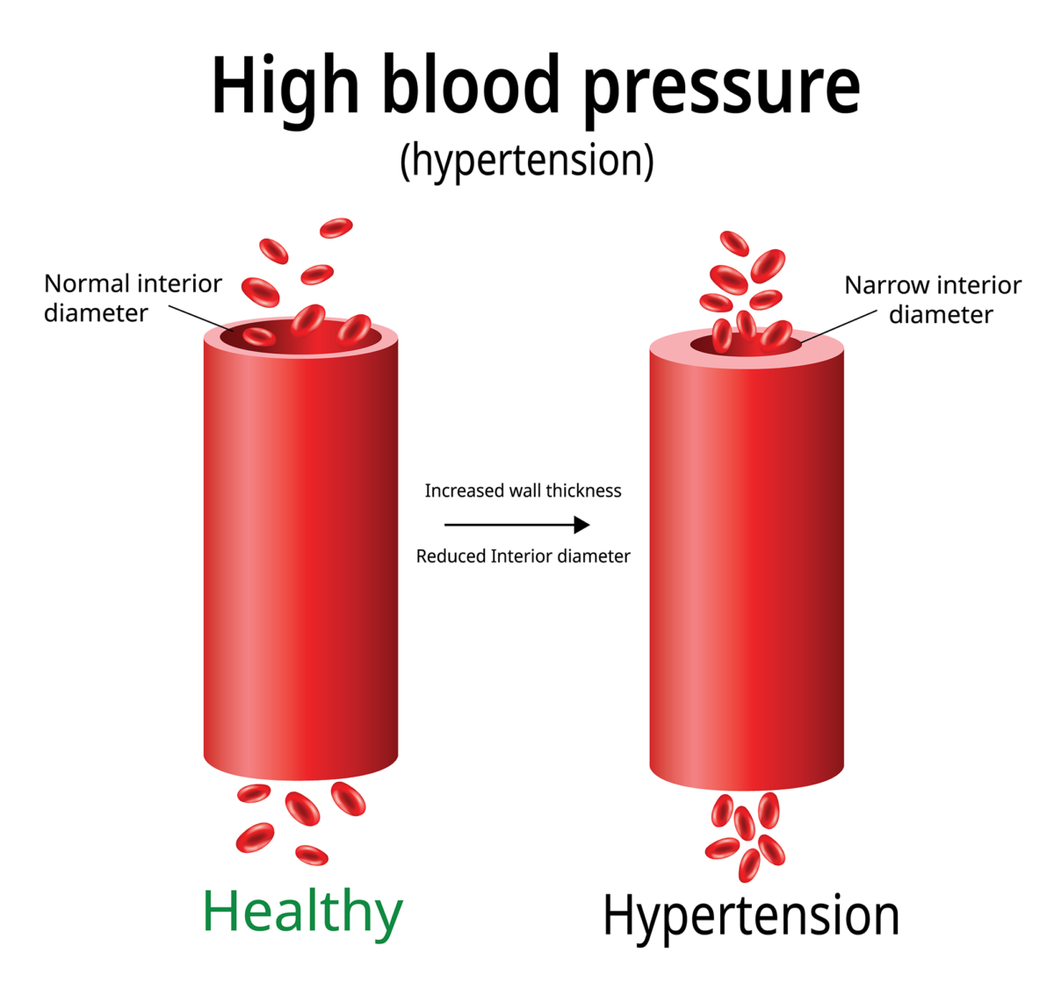
Overview of Hypertension
Hypertension is defined as persistently elevated arterial blood pressure, with no clear cut-off for diagnosis. Any increase in blood pressure can raise the risk of kidney or heart disease. Arbitrary thresholds are set to determine hypertension, primarily where treatment benefits outweigh risks. The standard threshold for diagnosing hypertension is a clinic systolic blood pressure of 140 mmHg or more (top number), or diastolic pressure of 90 mmHg or more (bottom number). Diagnosis is confirmed through ambulatory or home blood pressure monitoring.

Slide 20
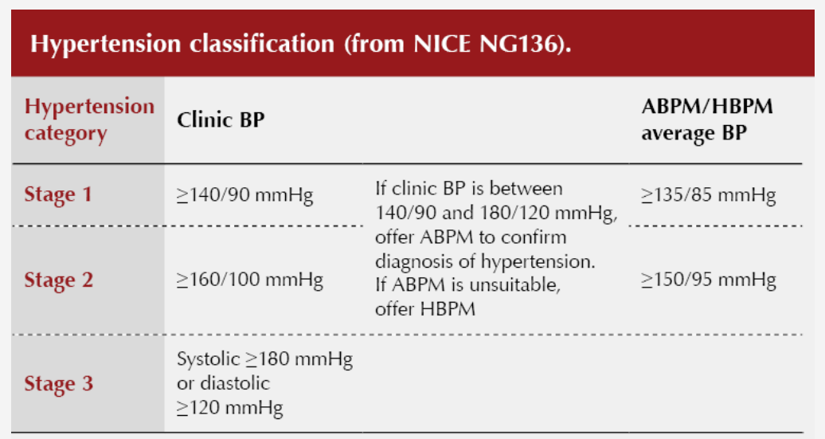
Overview of Hypertension
Hypertension - classified by the National Institute for Health and Care Excellence (NICE) in the UK according to severity as:
  Stage 1 hypertension — clinic blood pressure ranging from 140/90 mmHg to 159/99 mmHg and subsequent ABPM daytime average or HBPM average blood pressure ranging from 135/85 mmHg to 149/94 mmHg.
  Stage 2 hypertension — clinic blood pressure of 160/100 mmHg or higher but less than 180/120 mmHg and subsequent ABPM daytime average or HBPM average blood pressure of 150/95 mmHg or higher. (The upper limit of Stage 2 hypertension is variably defined in other guidelines internationally.)
  Stage 3 or severe hypertension — clinic systolic blood pressure of 180 mmHg or higher or clinic diastolic blood pressure of 120 mmHg or higher.

Slide 21
Hypertension
There are two main types of hypertension:
Primary (Essential) Hypertension: This type develops gradually over many years and has no identifiable cause. It is often influenced by genetic factors, lifestyle choices, and environmental factors such as diet and physical activity.
Secondary Hypertension: This type is caused by an underlying condition, such as kidney disease, hormonal disorders, or certain medications. It tends to appear suddenly and cause higher blood pressure than primary hypertension.
Hypertension often has no noticeable symptoms, which is why it is sometimes referred to as a "silent killer." If left untreated, it can lead to serious health complications, including heart disease, stroke, and kidney damage. Regular monitoring and management through lifestyle changes and medication can help control blood pressure and reduce the risk of these complications.

Slide 22
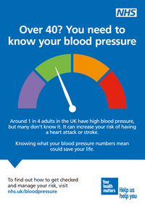
Overview of Hypertension
Prevalence: Approximately one in four adults in the UK has hypertension, equating to around 16 million people.
Age Factor: The risk of developing hypertension increases with age. It is more common in individuals over 50, but it can affect younger adults as well.
Risk Factors: Common risk factors for hypertension include
-obesity,
-physical inactivity,
-high salt intake,
-excessive alcohol consumption,
-smoking, and a
-family history of high blood pressure.
Silent Condition: Hypertension often has no symptoms, which is why it is essential to have regular blood pressure checks. Many people may not be aware they have high blood pressure until complications arise.

Slide 23
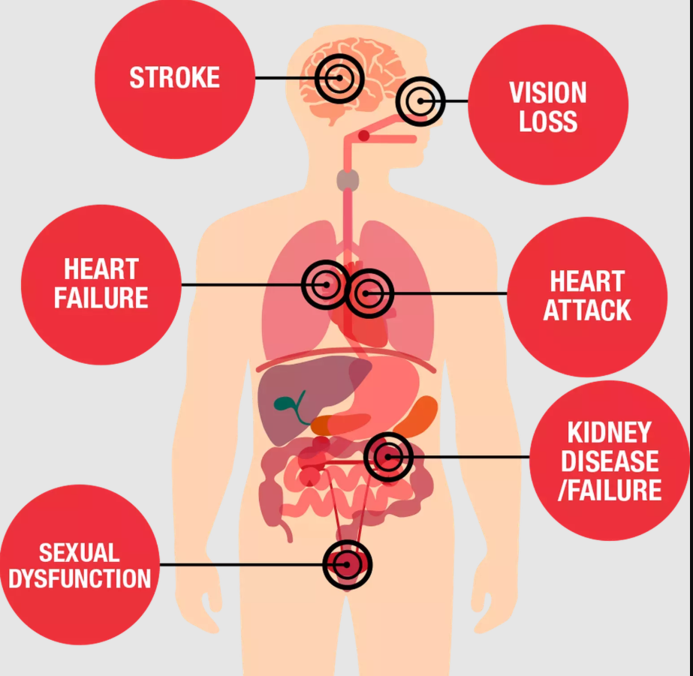
Overview of Hypertension
Health Complications: If left untreated, hypertension can lead to serious health issues, including heart disease, stroke, kidney disease, and vision loss.
Management: Hypertension can often be managed through lifestyle changes such as a balanced diet, regular exercise, reducing salt intake, and maintaining a healthy weight.
In some cases, medication may be required.
Monitoring: The NHS recommends that adults over 40 should have their blood pressure checked at least once every five years, or more frequently if they have risk factors for hypertension -> Community Pharmacy Blood Pressure Check Service

Slide 24
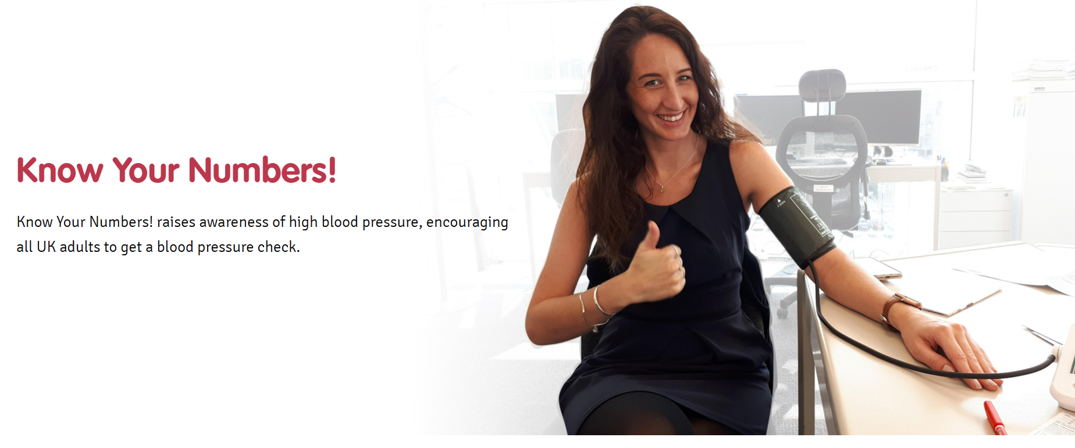
Hypertension
Public Awareness: Campaigns such as "Know Your Numbers!" aim to raise awareness about hypertension and encourage people to check their blood pressure regularly. (Blood Pressure UK)

Slide 25
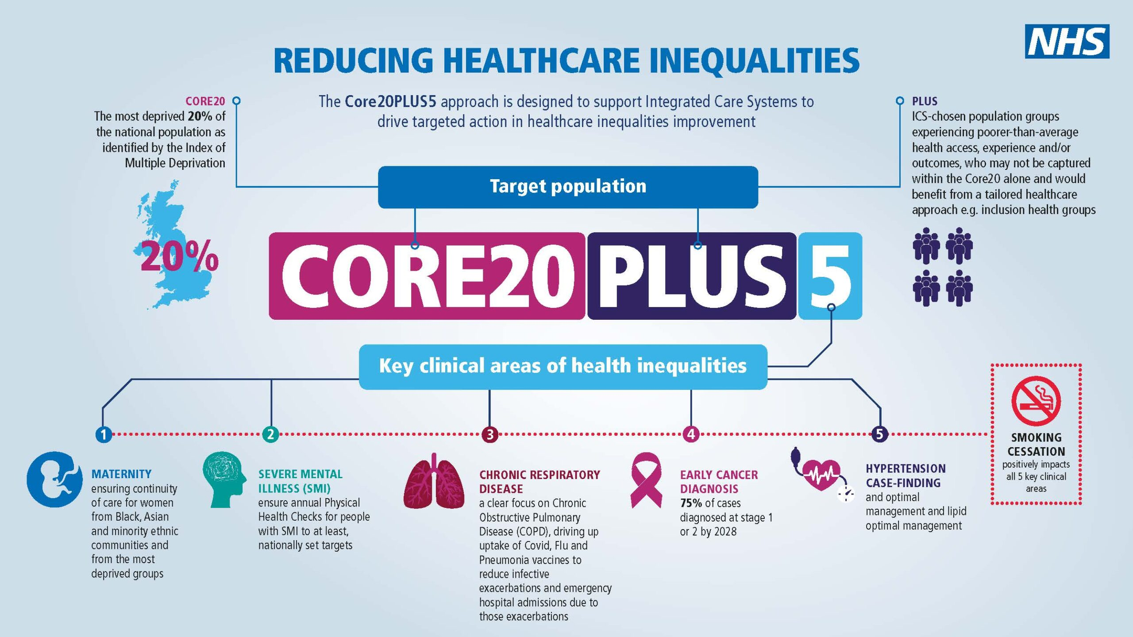
Hypertension
Forms Part of the Core20PLUS5 (adults) – an approach to reducing healthcare inequalities

Slide 26
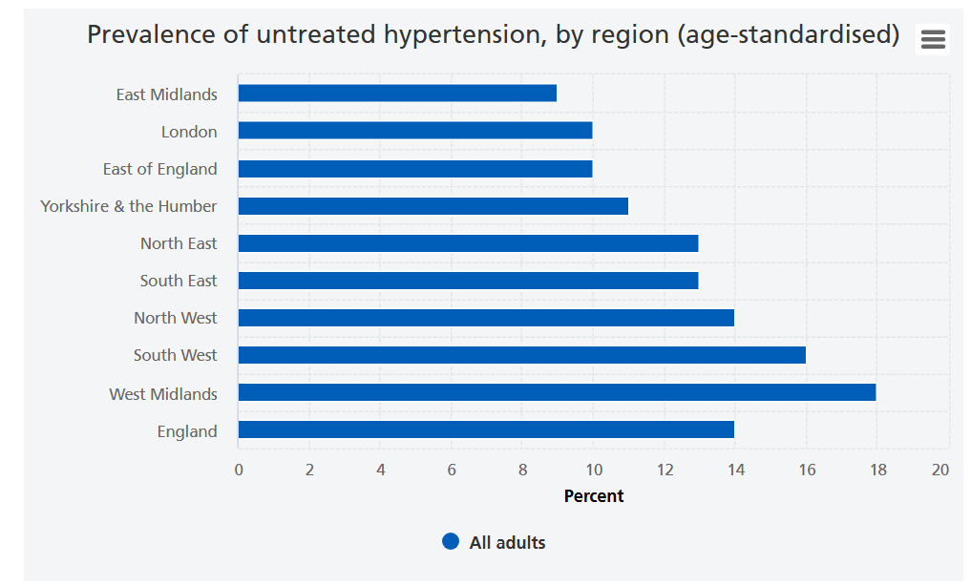
Hypertension
Adults' health - NHS England Digital Data 2022 published in Sep 2024
30% of adults had hypertension (high blood pressure), and this was greater among men (34%) than women (27%).
Overall, the prevalence of hypertension increased with age and was highest among those aged 75 and over for both men (66%) and women (71%).

Slide 27
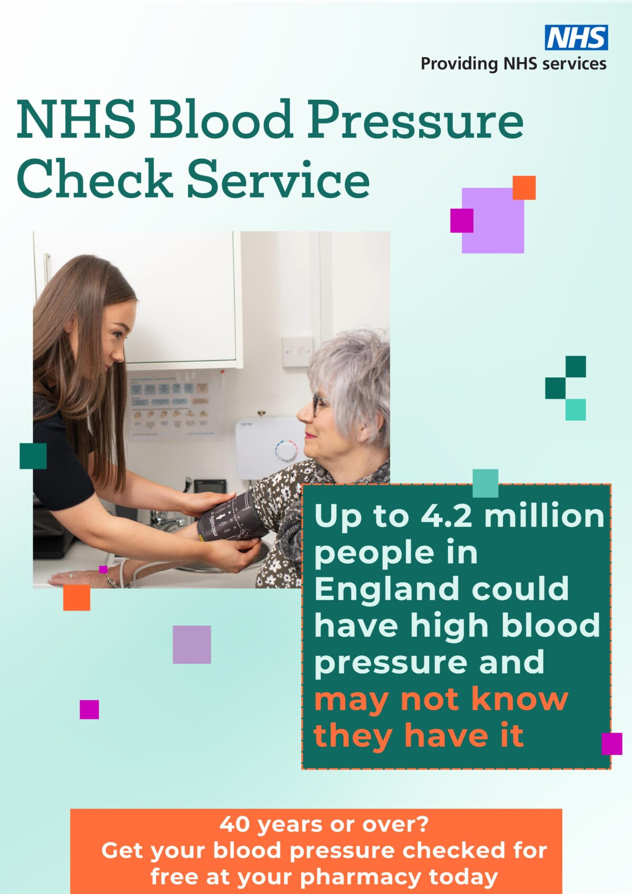
Clinic Blood Pressure Readings
NICE advises that a raised clinic BP (between 140/90 mmHg and 180/120 mmHg) should always be followed up with ambulatory BP monitoring (ABPM) to confirm or refute a diagnosis of hypertension.
ABPM is recommended as it is more accurate than clinic BP. If ABPM is unsuitable or not tolerated, then home BP monitoring (HBPM) can be performed.
These approaches help to avoid overdiagnosis due to ‘white coat’ hypertension where a person’s BP is elevated in a clinic environment but normal the rest of the time.

Slide 28
Community Pharmacy Blood Pressure Check Service (Hypertension Case Finding Service)
The service aims to:
Identify people aged 40 years or older, or at the discretion of pharmacy staff, people under the age of 40, with high blood pressure (who have previously not had a confirmed diagnosis of hypertension), and to refer them to general practice to confirm diagnosis and for appropriate management;
At the request of a general practice, undertake ad hoc clinic and ambulatory blood pressure measurements. These requests can be in relation to people either with or without a diagnosis of hypertension; and
Provide another opportunity to promote healthy behaviours to patients.
Inclusion criteria
Adults who are 40 years old or over, who do not have a current diagnosis of hypertension;
Patients, by exception, under the age of 40 who request the service because they have a recognised family history of hypertension may be provided the service at the pharmacy staff’s discretion;
Patients between 35 and 39 years old who are approached about or request the service may be tested at the pharmacy staff’s discretion; and
Adults, with or without a prior diagnosis of hypertension specified by a general practice for the measurement of blood pressure (clinic and ambulatory blood pressure checks). This process should be agreed locally with general practices.
Exclusion criteria
People under the age of 40 years old, unless at the discretion of the pharmacy staff or unless they have been specified by a general practice for the measurement of blood pressure; and
People who have their blood pressure regularly monitored by a healthcare professional, unless the general practice requests the service is provided for the patient. Requests should be sent via a process which is agreed locally with general practices;
People who require daily blood pressure monitoring for any period of time e.g. 7-day clinic checks as an alternative to ABPM; and
People with a diagnosis of atrial fibrillation or history of irregular heartbeat.
General practice referrals
If practices want to refer patients who have already been diagnosed with hypertension for blood pressure checks, then pharmacy owners should work with their practices to agree a local process by which this will work; there are no specific requirements set for this process, and it could involve the practice agreeing that a specific list of patients can access the service or a cohort of patients could be specified.
General practices will also be able to refer patients requiring ABPM; in this scenario it is recommended that this referral is made electronically to the pharmacy.

Slide 29
Community Pharmacy Blood Pressure Check Service (Hypertension Case Finding Service)
To provide the service Pharmacies must:
The responsible pharmacist must ensure that delegated tasks are being undertaken safely by competent pharmacy staff. The pharmacy contractor must ensure all pharmacy staff providing the service are appropriately trained. Pharmacy staff providing the service must:
• have read and understood the operational processes to provide the service as described in this service specification.
• be familiar with the parts of NICE Guideline (NG136) Hypertension in adults: diagnosis and management relevant to the role they are undertaking within the service.
• complete training (e-learning or face-to-face) on how to use the blood pressure monitoring equipment which should be provided by their equipment manufacturer
Pharmacies must have a consultation room that will be used for the provision of the service which meets the requirements in the terms of service
The service will usually be provided on the pharmacy premises, but patients can also be identified, and the service provided in other locations outside the pharmacy, such as areas not designated part of the pharmacy within supermarkets or large stores or in community locations with agreement from the commissioner.
This may include, but is not limited to:
• community centres
• sports grounds
• places of worship.

Slide 30
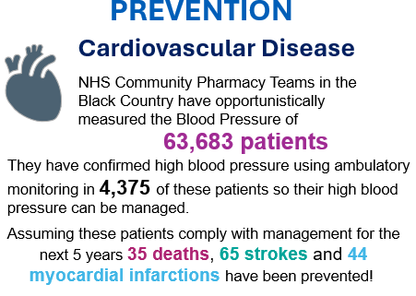
Black Country Community Pharmacy Impact
April ‘24 - December ‘24
sukhy.somal@nhs.net – Head of Community Pharmacy Clinical Services

Slide 31
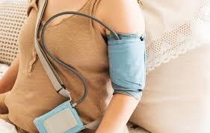
Ambulatory Blood Pressure Monitoring
NICE guidance recommends taking at least two measurements per hour during the individual's usual waking hours, typically between 08:00 and 22:00. The average value of at least 14 measurements during waking hours is considered the BP reading.
Patients should visit their pharmacy or GP practice during early hours to have the ABPM device fitted and return the same day before closing to have it removed. The fitting process should take approximately 20 minutes.

Slide 32
Ambulatory Blood Pressure Monitoring
The ABPM device must not get wet therefore any activity such as showering or swimming should be avoided during the duration of wearing the ABPM device. Vigorous exercise should also be avoided as this can cause spikes in BP readings. Patients should not drive during the monitoring period, due to the risk of distraction caused by the cuff inflating; patients who are occupational drivers will only be able to have the ABPM device fitted on a non-working day.
Patients should not remove the ABPM device themselves, as improper removal could pose a risk of harm to the patient and potentially damage the device.

Slide 33
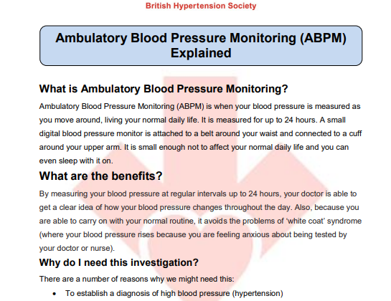
Barriers to Ambulatory Blood Pressure Monitoring
Process Familiarity: ABPM process mirrors that performed by GP practices to alleviate patient concerns.
Patient Reassurance: Ask questions to fully understand the process and address potential concerns to build confidence.
Advantages of ABPM: Benefits of ABPM include accurate diagnosis and avoiding unnecessary appointments or treatments.
Patient Comfort and Compliance: ABPM device should be fitted correctly for comfort, promoting compliance during the monitoring period.
Learning Material: You should be provided with information regarding ABPM, which can be sent digitally (e.g., using Accurx).

Slide 34
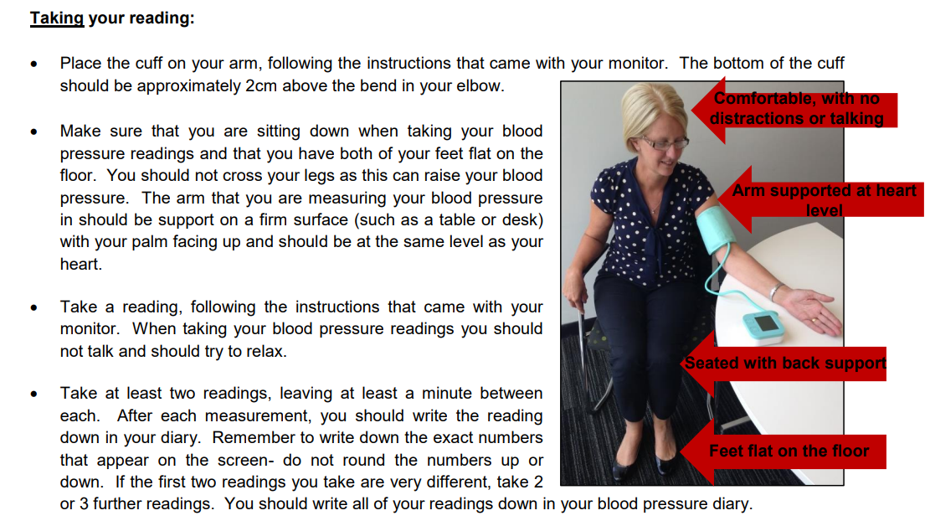
How to best support patients completing Home Blood Pressure Readings
Patient Competence: You should be able to perform HBPM correctly based on clear instructions from your surgery (GP, Nurse, HCA or Pharmacist).
Equipment Requirements: Use an approved BP monitor that measures upper arm BP. Wrist BP monitors or smartwatches are not recommended, as they provide less accurate readings.
Educational Materials: Supportive materials are available, including links to instructional videos from the British Heart Foundation.
Recording Schedule: BP should be recorded twice daily, ideally in the morning and evening, for a minimum of 4 days, preferably for 7 days, as per NICE guidelines.

Slide 35
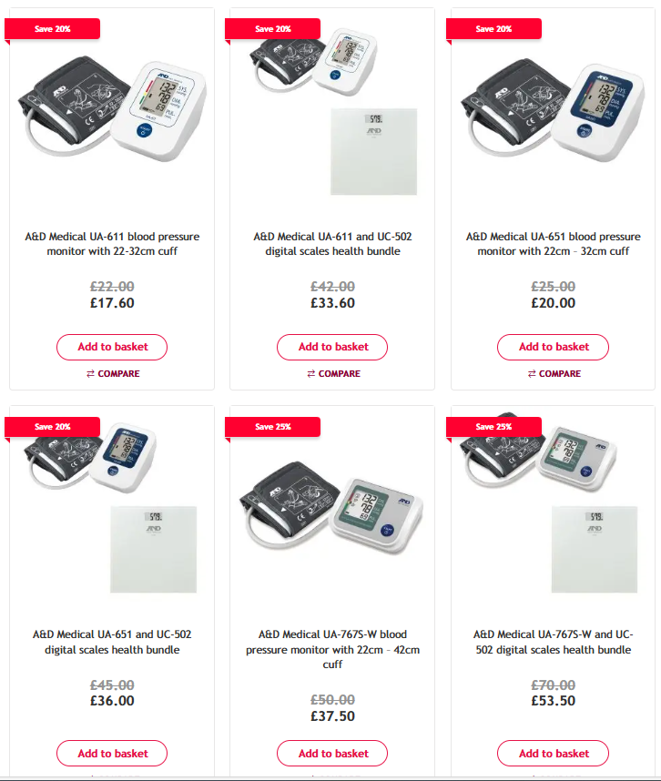
Examples of Home BP Monitors
Most cost-effective monitors start from around £20 and are available in most local pharmacies and larger supermarkets.
Available for rent from GP practices (deposit).
Choose a blood pressure monitor that measures your blood pressure at your upper arm. If you cannot use a cuff on your upper arm, you can use a cuff that wraps around your wrist instead.
Keeping a note of your readings can help you track your blood pressure over time
- On your mobile phone
Pen and paper
BP machine with memory storage (can be expensive)
Check if it’s UK approved by the British and Irish Hypertension Society (BIHS).
Home blood pressure machine should be serviced every 2 years.

Slide 36

Thank you for listening!

Slide 37
Table Feedback
What is one new thing you learned about hypertension today?
Have you accessed any of these services or bought your own machine? What stops you? How can we make this more accessible for our patient population?
Was the information today easy to understand and relevant to you or a family member?
What would you like us to cover in the next PPG meeting?

Slide 38
Next PCN PPG
DATE: TBC
THEME: TBC
Venue to be confirmed.
Follow us on Facebook – Dudley and Netherton Primary Care Network
Twitter - @DNPCN1

